Slide 1
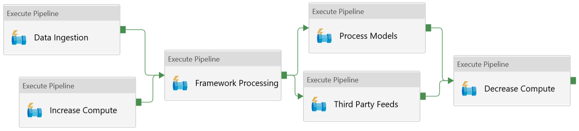
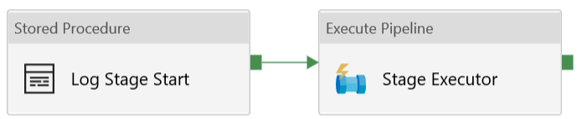
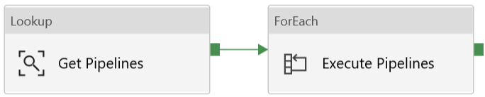
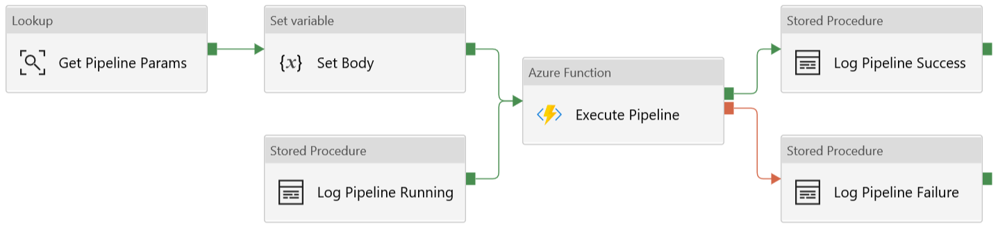
Grandparent
v1.0
Parent
Child

Slide 2
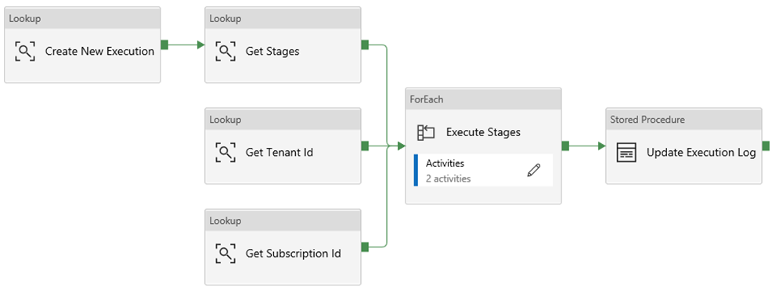
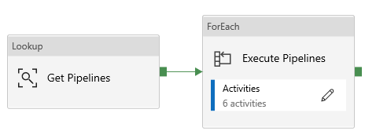
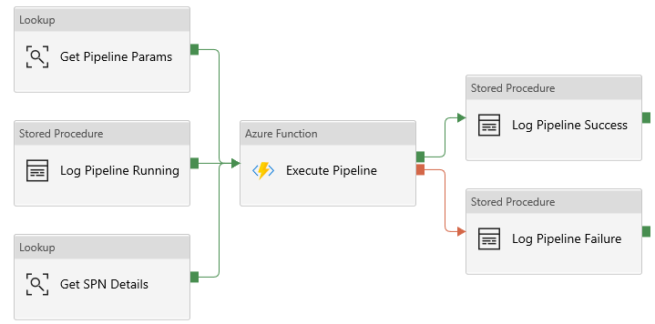
Grandparent
v1.1
Parent
Child

Slide 3
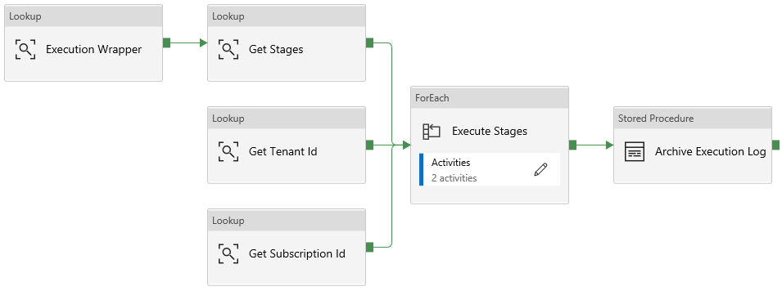
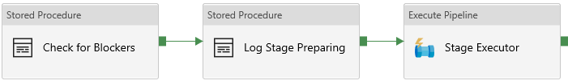
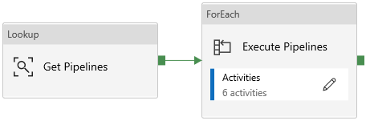
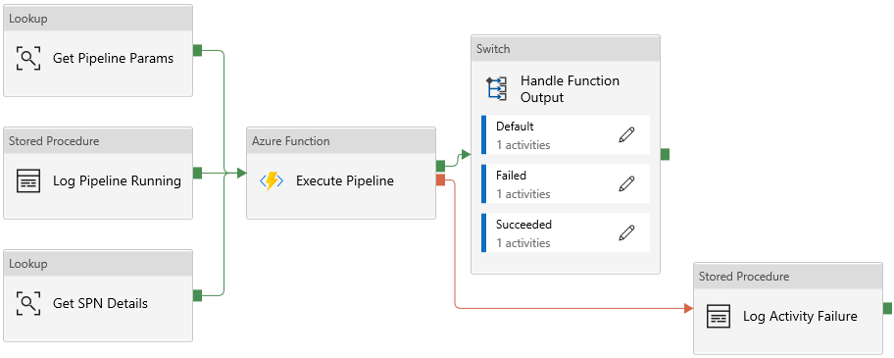
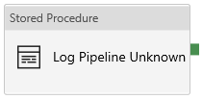
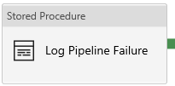
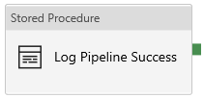
Grandparent
v1.2
Parent
Child
@{Case}

Slide 4
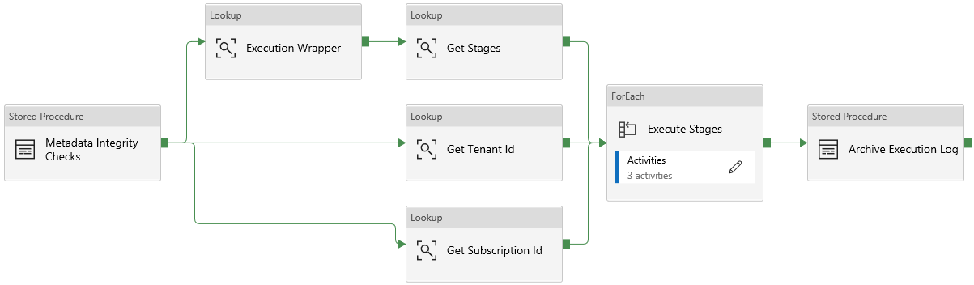
Grandparent
v1.3
Parent
Child
@{Case}

Slide 5
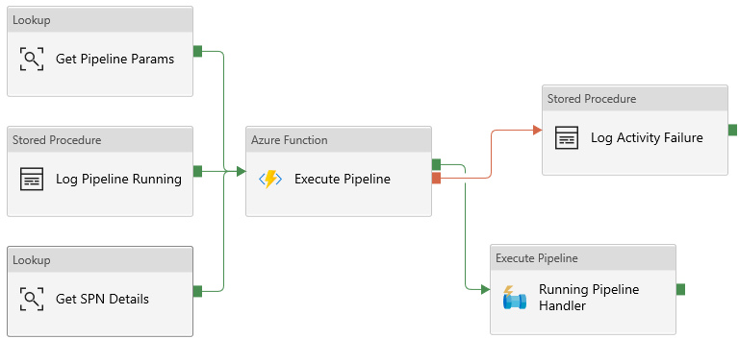
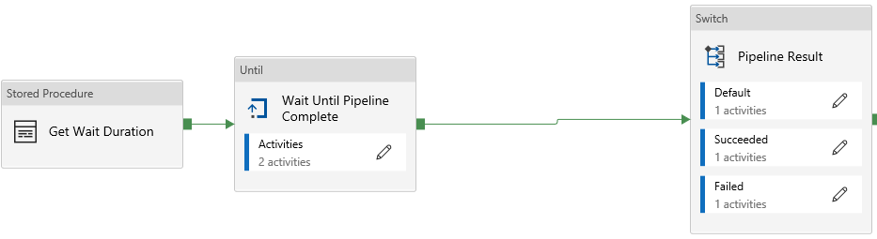
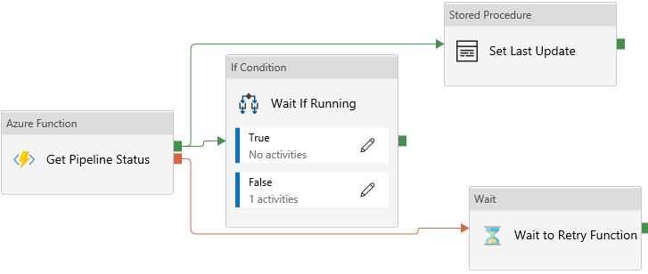
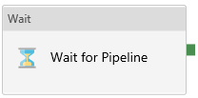
Grandparent
(optional)
v1.4
Parent
Child
Infant
@{Case}
@{False}

Slide 6
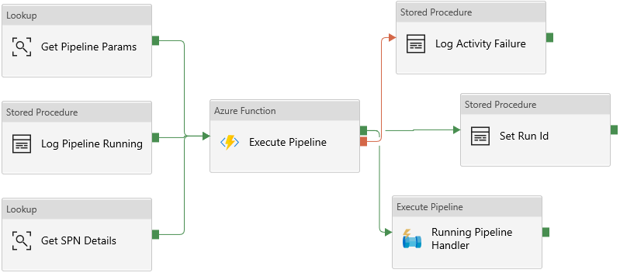
Grandparent
(optional)
v1.5
Parent
Child
Infant
@{Case}
@{False}

Slide 7
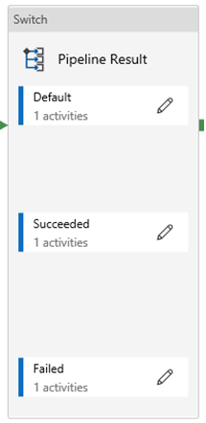
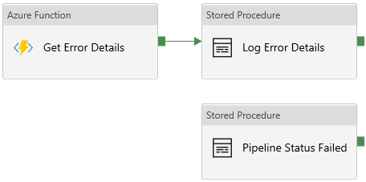
Grandparent
(optional)
v1.6
Parent
Child
Infant
@{Case}
@{Case}
@{False}

Slide 8
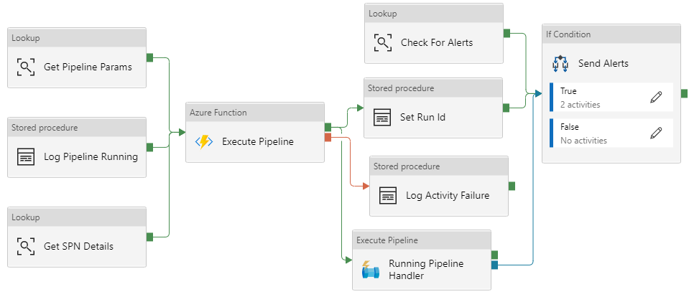

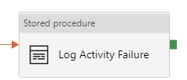
Grandparent
(optional)
v1.7
Parent
Child
Infant
@{Case}
@{Case}
@{False}

Slide 9
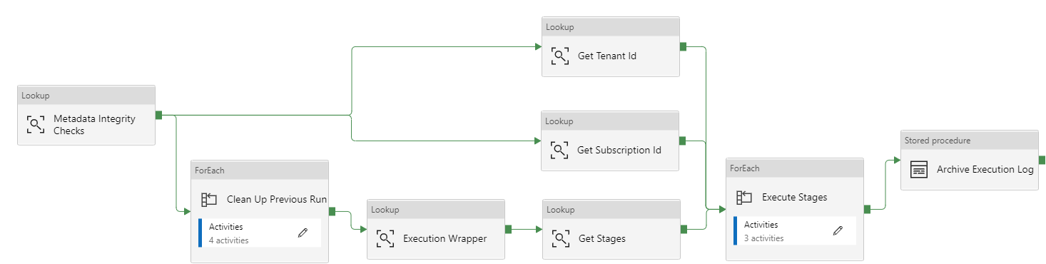

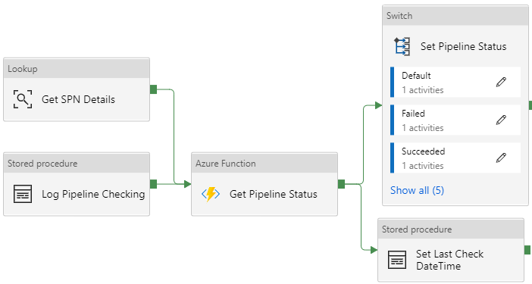
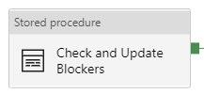



Grandparent
(optional)
v1.8
Parent
Child
Infant
@{Case}
@{Case}
@{False}

Slide 10
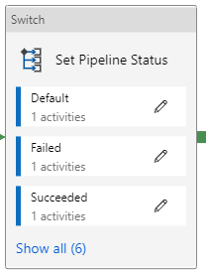


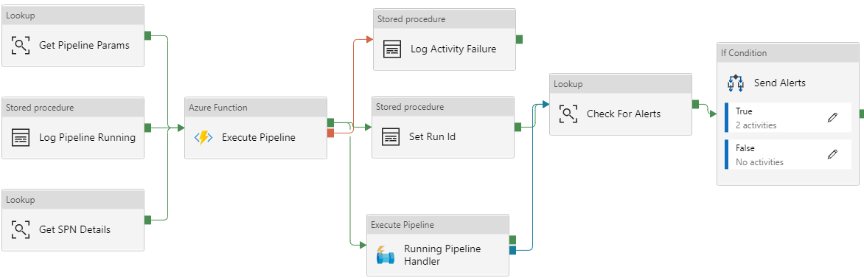

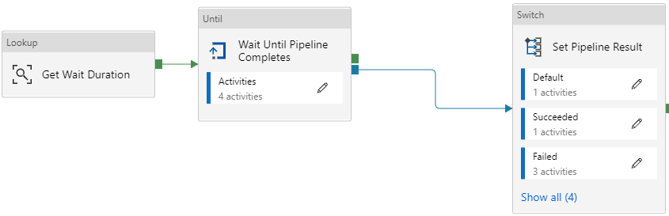
Grandparent
(optional)
v1.8.3
Parent
@{Case}
Child
@{True}
Infant
@{Case}
@{False}

Slide 11

Grandparent
(optional)
v1.8.5
Parent
@{Case}
Child
@{True}
Infant
@{Case}
@{False}

Slide 12
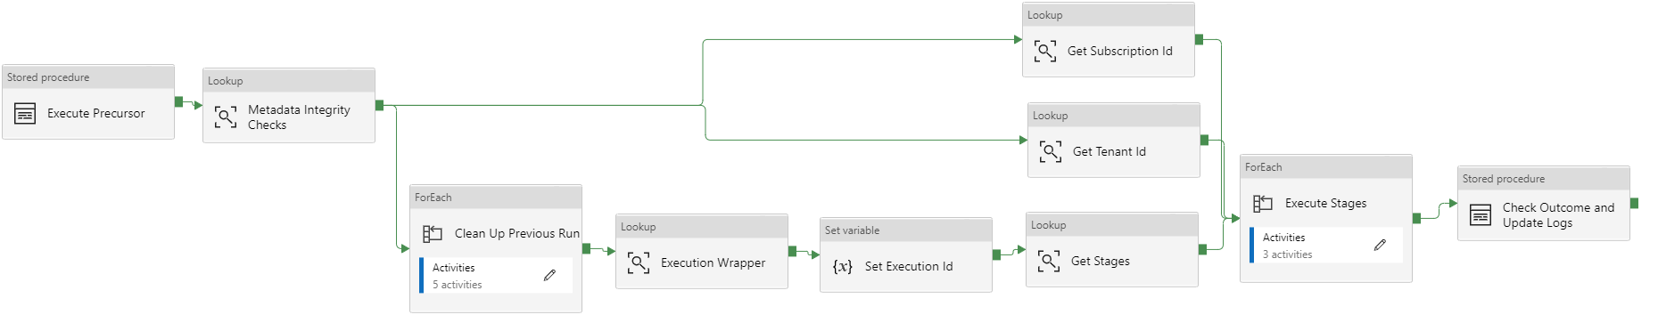
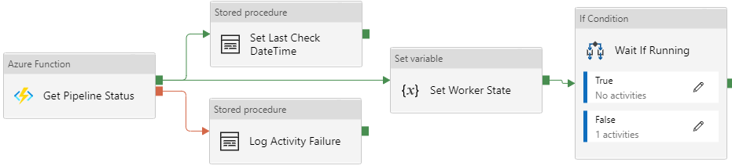
Grandparent
(optional)
v1.8.6
Parent
@{Case}
Child
@{True}
Infant
@{Case}
@{False}

Slide 13
v1.9

Slide 14
Success
Execute Pipeline
Fail
Complete
Skip

